Slide 1
Chapter 5
Data and Process Modeling

Slide 2
Learning Objectives (1 of 2)
After this chapter, you will be able to:
Describe the relationship between logical and physical models
Explain data flow diagrams
Draw the four basic data flow diagram symbols
Explain the six guidelines used when drawing data flow diagrams
Draw context diagrams
Draw diagram 0 data flow diagrams

Slide 3
Learning Objectives (2 of 2)
Draw lower-level data flow diagrams
Explain how to level and balance data flow diagrams
Create a data dictionary
Apply process description tools in modular design

Slide 4
Logical Versus Physical Models (1 of 2)
Logical model
Shows what the system must do, regardless of how it will be implemented physically
Physical model
Describes how the system will be constructed

Slide 5
Logical Versus Physical Models (2 of 2)
Many analysts follow a four-model approach
Physical model of the current system
Logical model of the current system
Logical model of the new system
Physical model of the new system

Slide 6
Data Flow Diagrams
Systems analysts use graphical techniques to describe an information system
Data flow diagram (DFD)
Uses various symbols to show how the system transforms input data into useful information
Shows how data moves through an information system but does not show program logic or processing steps

Slide 7
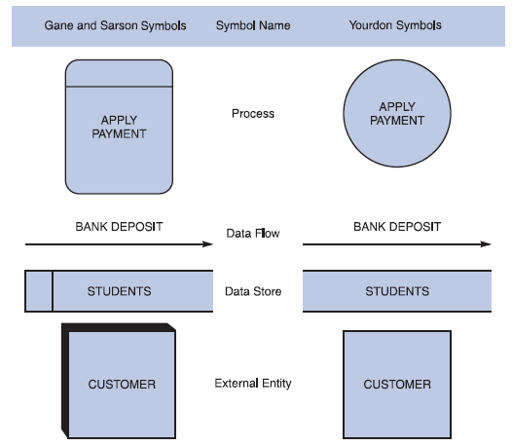
Data Flow Diagram Symbols (1 of 9)
Four basic symbols represent processes, data flows, data stores, and entities
FIGURE 5-1 Data flow diagram symbols, symbol names, and examples of the Gane and Sarson and Yourdon symbol sets

Slide 8
Data Flow Diagram Symbols (2 of 9)
Process symbols
Process receives input data and produces output
Contains business logic that transforms the data
Process name identifies a specific function
In DFDs, a process symbol can be referred to as a black box

Slide 9
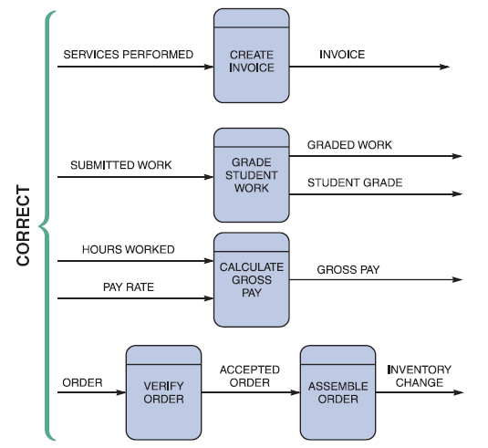
Data Flow Diagram Symbols (3 of 9)
Data flow symbols
Line with a single or double arrowhead
FIGURE 5-3 Examples of correct combinations of data flow and process symbols

Slide 10
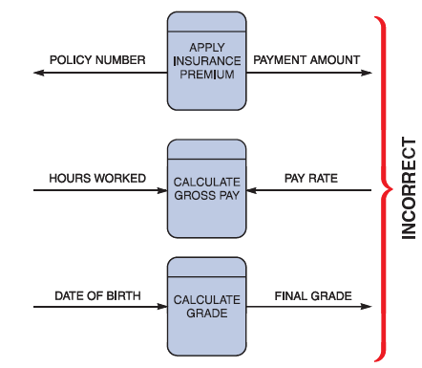
Data Flow Diagram Symbols (4 of 9)
Data flow and process combinations that must be avoided
Spontaneous generation
Black holes
Gray holes
FIGURE 5-4 Examples of incorrect combinations of data flow and process symbols. APPLY INSURANCE PREMIUM has no input and is called a spontaneous generation process. CALCULATE GROSS PAY has no outputs and is called a black hole process. CALCULATE GRADE has an input that is obviously unable to produce the output. This process is called a gray hole.

Slide 11
Data Flow Diagram Symbols (5 of 9)
Data store symbol
Represent data that the system stores
DFD does not show the detailed contents of a data store
Specific structure and data elements are defined in the data dictionary
A data store must be connected to a process with a data flow

Slide 12
Data Flow Diagram Symbols (6 of 9)
Entity symbol
Shows how the system interfaces with the outside world
DFD shows only external entities that provide data to the system or receive output
DFD entities also are called terminators because they are data origins or final destinations
Source and sink entities

Slide 13
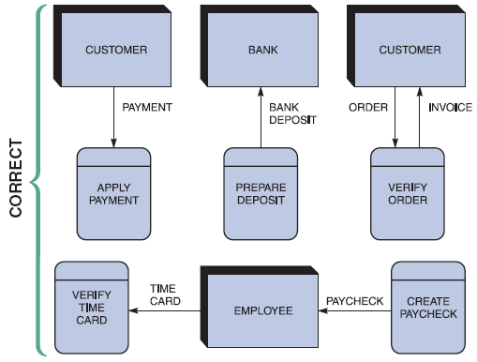
Data Flow Diagram Symbols (7 of 9)
FIGURE 5-7 Examples of correct uses of external entities in a data flow diagram.

Slide 14
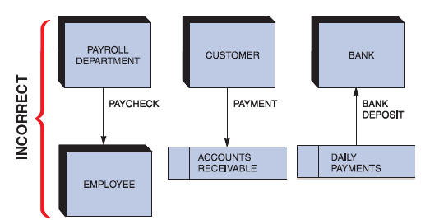
Data Flow Diagram Symbols (8 of 9)
FIGURE 5-8 Examples of incorrect uses of external entities. An external entity must be connected by a data flow to a process, and not directly to a data store or to another external entity.

Slide 15
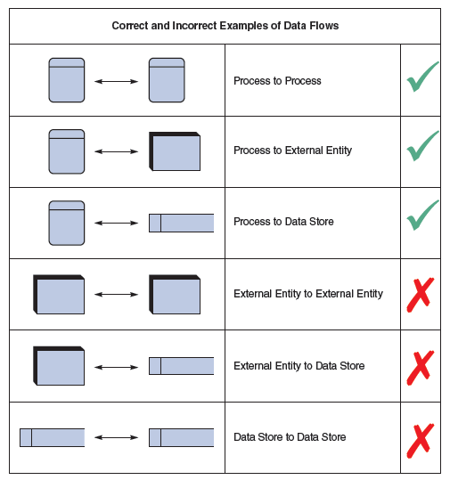
Data Flow Diagram Symbols (9 of 9)
Using DFD symbols
FIGURE 5-9 Examples of correct and incorrect uses of data flows.

Slide 16
Drawing Data Flow Diagrams (1 of 2)
Graphical model is created based on fact-finding results
Review guidelines for drawing DFDs
Apply guidelines and create a set of DFDs

Slide 17
Drawing Data Flow Diagrams (2 of 2)
Guidelines
Draw the context diagram so that it fits on one page
Use the name of the information system as the process name in the context diagram
Use unique names within each set of symbols
Do not cross lines
Provide a unique name and reference number for each process
Ensure that the model is accurate, easy to understand, and meets the needs of its users

Slide 18
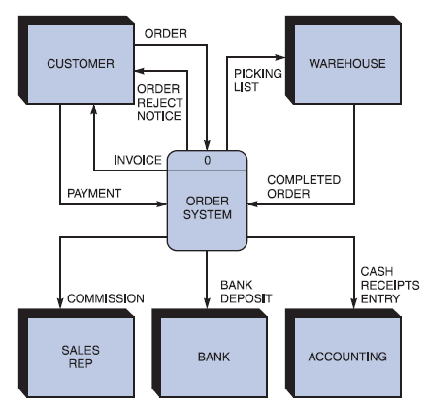
Drawing a Context Diagram
First step in constructing a set of DFDs
FIGURE 5-11 Context diagram DFD for an order system.

Slide 19
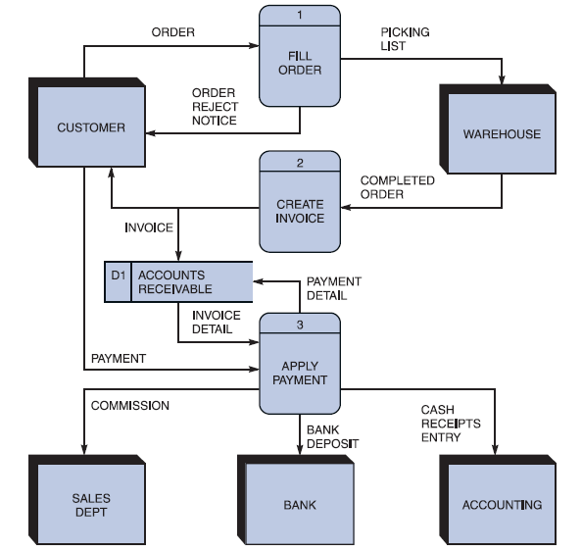
Drawing a Diagram 0 DFD
Shows the detail inside the black box
FIGURE 5-13 Diagram 0 DFD for the order system.

Slide 20
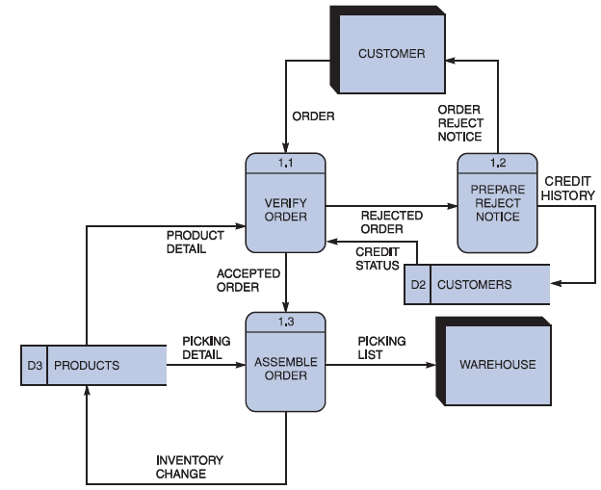
Drawing Lower-Level DFDs (1 of 5)
Leveling and balancing techniques are used
FIGURE 5-14 Diagram 1 DFD shows details of the FILLORDER process in the order system

Slide 21
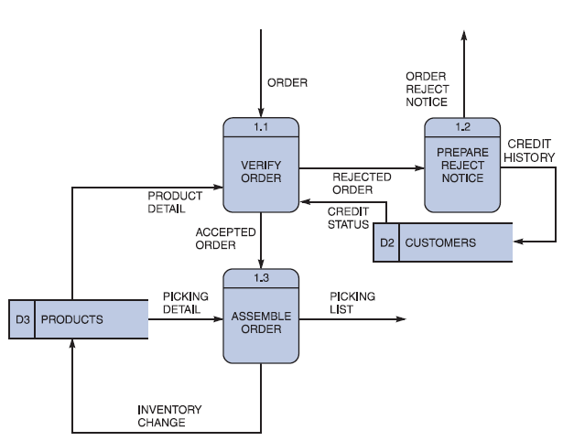
Drawing Lower-Level DFDs (2 of 5)
FIGURE 5-15 This diagram does not show the symbols that connect to data flows entering or leaving FILL ORDER on the context diagram.

Slide 22
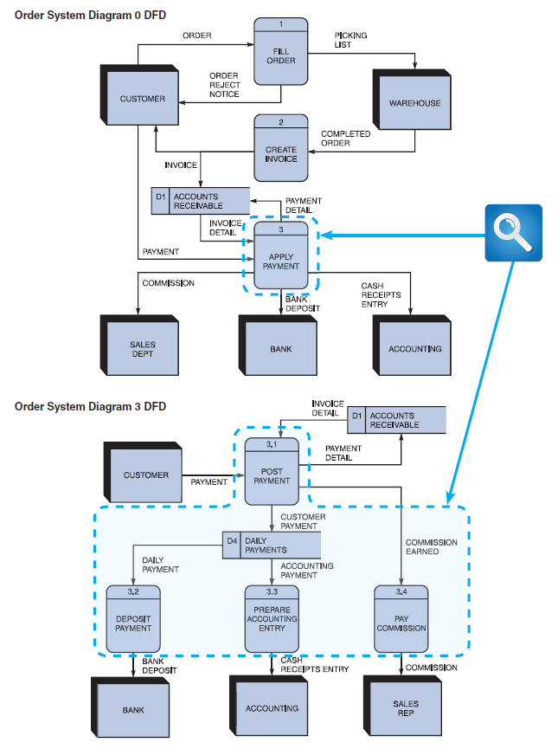
Drawing Lower-Level DFDs (3 of 5)
FIGURE 5-16 The order system diagram 0 is shown at the top of the figure, and exploded diagram 3 DFD (for the APPLY PAYMENT process) is shown at the bottom. The two DFDs are balanced because the child diagram at the bottom has the same input and output flows as the parent process 3 shown at the top.

Slide 23
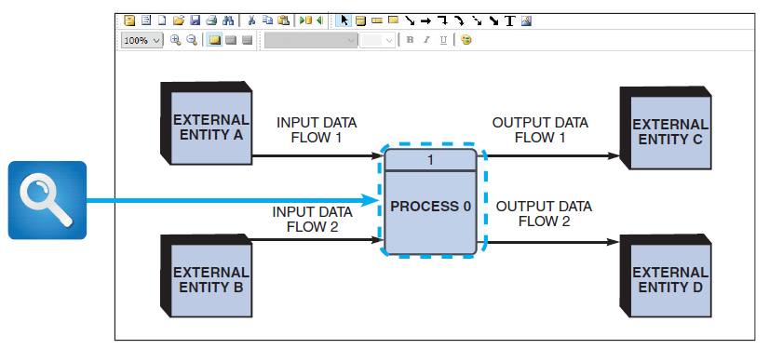
Drawing Lower-Level DFDs (4 of 5)
FIGURE 5-17 Example of a parent DFD diagram, showing process 0 as a black box.

Slide 24
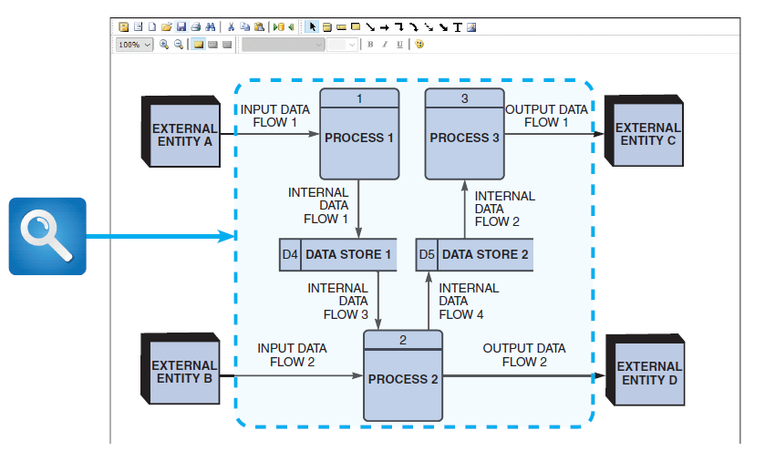
Drawing Lower-Level DFDs (5 of 5)
FIGURE 5-18 In the next level of detail, the process 0 black box reveals three processes, two data stores, and four internal data flows — all of which are shown inside the dashed line.

Slide 25
Data Dictionary (1 of 11)
Central storehouse of information about a system’s data
An analyst uses the data dictionary to collect, document, and organize specific facts about a system
Defines and describes all data elements and meaningful combinations of data elements

Slide 26
Data Dictionary (2 of 11)
Data element (i.e., data item or field)
Smallest piece of data that has meaning within an information system
Combined into records (i.e., data structures)
Record: meaningful combination of related data elements that is included in a data flow or retained in a data store

Slide 27
Data Dictionary (3 of 11)
Using CASE tools for documentation
More complex the system, more difficult it is to maintain full and accurate documentation
Modern CASE tools simplify the task
A CASE repository ensures data consistency

Slide 28
Data Dictionary (4 of 11)
Documenting the data elements
Every data element in the data dictionary should be documented
Objective: provide clear, comprehensive information about the data and processes that make up a system

Slide 29
Data Dictionary (5 of 11)
Recorded and described attributes
Data element name and label
Alias
Type and length
Default value
Acceptable values
Source
Security
Responsible user(s)
Description and comments

Slide 30
Data Dictionary (6 of 11)
Documenting the data flows
Data flow name or label
Description
Alternate name(s)
Origin
Destination
Record
Volume and frequency

Slide 31
Data Dictionary (7 of 11)
Documenting the data stores
Data store name or label
Description
Alternate name(s)
Attributes
Volume and frequency

Slide 32
Data Dictionary (8 of 11)
Documenting the processes
Process name or label
Description
Process number
Process description

Slide 33
Data Dictionary (9 of 11)
Documenting the entities
Entity name
Description
Alternate name(s)
Input data flows
Output data flows

Slide 34
Data Dictionary (10 of 11)
Documenting the records
Record or data structure name
Definition or description
Alternate name(s)
Attributes

Slide 35
Data Dictionary (11 of 11)
Data dictionary reports
Alphabetized list of all data elements
Report describing each data element and indicating the user or department
Report of all data flows and data stores that use a particular data element
Detailed reports showing all characteristics of data elements, records, data flows, processes, or any other selected item stored in the data

Slide 36
Process Description Tools in Modular Design (1 of 6)
Documents the details of a functional primitive and represents a specific set of processing steps and business logic
Typical tools: structured English, decision tables, and decision trees
Process descriptions in object-oriented development
O-O analysis combines data and processes that act on the data into objects, and similar objects can be grouped together into classes
O-O processes are called methods

Slide 37
Process Description Tools in Modular Design (2 of 6)
Modular design
Based on combinations of logical structures (i.e., control structures), which serve as building blocks for the process
Sequence
Selection
Iteration

Slide 38
Process Description Tools in Modular Design (3 of 6)
Structured English
Subset of standard English that describes logical processes clearly and accurately
Use only the three building blocks of sequence, selection, and iteration
Use indentation for readability
Use a limited vocabulary

Slide 39
Process Description Tools in Modular Design (4 of 6)
Decision tables
Logical structure that shows every combination of conditions and outcomes
Number of rules doubles each time a condition is added
Best way to describe a complex set of conditions

Slide 40
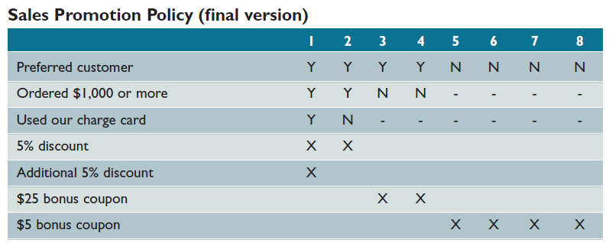
Process Description Tools in Modular Design (5 of 6)
FIGURE 5-35 In this version, dashes have been added to indicate that a condition is not relevant. At this point, it appears that several rules can be combined.

Slide 41
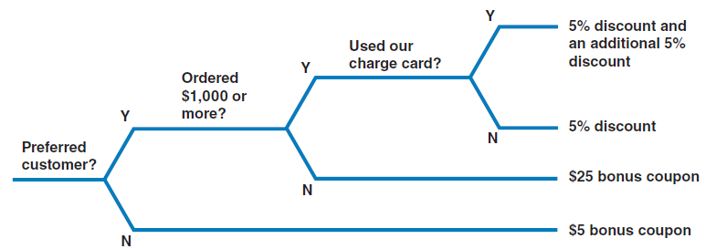
Process Description Tools in Modular Design (6 of 6)
Decision trees
Graphical representation of conditions, actions, and rules found in a decision table
FIGURE 5-36 This example is based on the same Sales Promotion Policy shown in the decision tables in Figures 5-34 and 5-35 on the previous page. Like a decision table, a decision tree shows all combinations of conditions and outcomes. The main difference is the graphical format, which many viewers find easier to interpret

Slide 42
Summary
Structured analysis tools
Used to develop a logical model during one systems analysis phase and a physical model during the systems design phase
Data and process modeling
Main tools: DFDs, data dictionary, and process description
Each functional primitive process is documented
Structured English, decision tables, and decision trees

